Slide 1

Madhav Institute of Technology & Science
A GOVT. AIDED UGC AUTONOMOUS INSTITUTE , AFFILIATED TO R.G.P.V. BHOPAL (M.P.) INDIA, NAAC ACCREDITED WITH A++ GRADE
DEPARTMENT OF ENGINEERING MATHEMATICS AND COMPUTING
Data Science Using Python
(250504)
PROFICIENCY IN COURSE
Presented To: Dr. Atul Kumar Ray

Slide 2
Presented By:
Sumit Singh Tomar (0901MC211062)
Tanya Jain (0901MC211063)
Utkarsh Gupta (0901MC211064)
Vaibhav Shrivastava (0901MC211065)
Vinay Patel (0901MC211066)
Vivek Mehta (0901MC211067)
Yash Mathe (0901MC211068)

Slide 3
Content
Introduction
Control Structures
Types of Control statements
Functions

Slide 4
INTRODUCTION
In this presentation we are going to discuss about control structures using different dataset ,if-else family , for loop with if breaks , while loop, Functions.
Control structures using different dataset- Control structures using different datasets involve applying conditional statements (if-else), loops (for and while), and functions to manipulate and analyze diverse sets of data for various data science and programming tasks.
The if-else family-The "if-else" family of control structures allows for conditional execution of code based on the evaluation of a specified condition. It typically consists of an "if" statement followed by zero or more "elif" (else if) statements and an optional "else" statement. These statements collectively form a decision tree where the code block associated with the first true condition is executed. If none of the conditions are true, the "else" block (if present) is execute.

Slide 5
For loop with if breaks- A "for loop with if breaks" is a construct in programming that repeatedly performs a set of actions (loop) as long as a condition is met , and it can be interrupted or exited prematurely when a specific condition is satisfied.
While loop-A "while loop" is a programming structure that continuously repeats a set of instructions as long as a specified condition remains true.
Functions – A function is a block of reusable code that performs a specific task or set of tasks when called. Functions are defined using the def keyword, and they can accept input arguments, process them, and return results. They are a fundamental concept in Python and help in organizing and reusing code effectively.

Slide 6
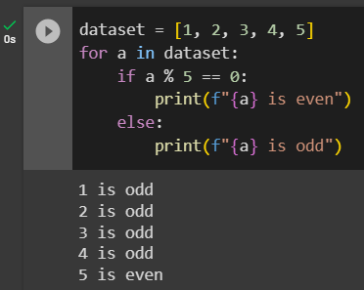
CONTROL STRUCTURES USING DIFFERENT DATASET
Control structures are essential building blocks in programming, enabling you to control the flow of execution based on conditions and perform repetitive tasks. Python provides various control structures, including if-else statements, for loops, and while loops, which can be applied to different datasets to manipulate and analyze data effectively.
If-else statement

Slide 7
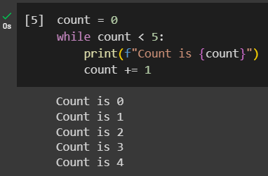
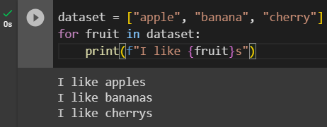
While loops
For loops

Slide 8

For Loop

Slide 9
For loops are used for iterating over a sequence of elements, such as lists, arrays, or data frames. In data science, for loops can be used for feature engineering, data preprocessing, or calculating summary statistics. Consider the following example where we calculate the mean of each column in a dataset:

Slide 10
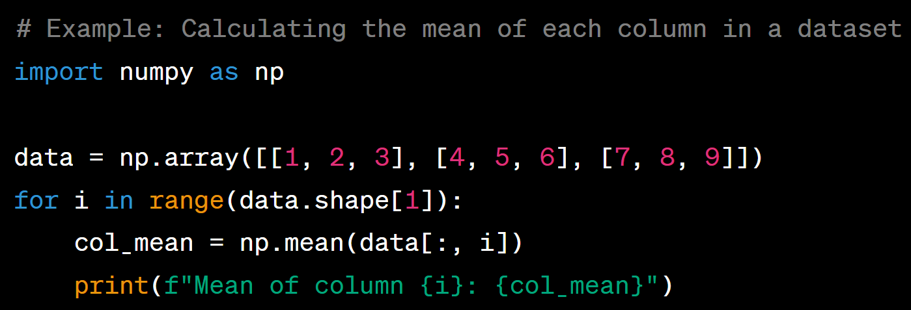
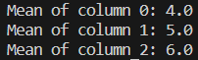
Example:
Output

Slide 11
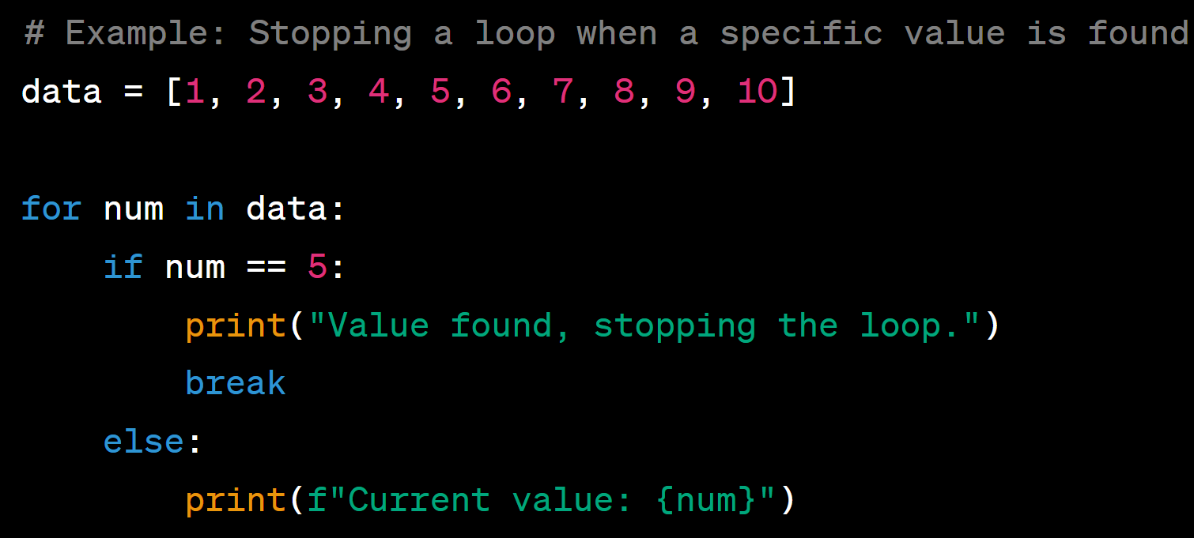
Example:
Output

Slide 12
For Loop with if breaks

Slide 13
A for loop with an if condition and a break statement is useful for stopping the loop's execution based on a certain condition. This can be handy in scenarios where we need to terminate the loop when a specific criterion is met. Here's an example where we stop the loop when a particular value is found:

Slide 14
If – Else

Slide 15
The if-else statement is used to execute both the true part and the false part of a given condition. If the condition is true, the if block code is executed and if the condition is false, the else block code is executed.

Slide 16
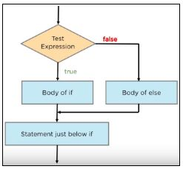
Flow Chart of If – Else Condition

Slide 17
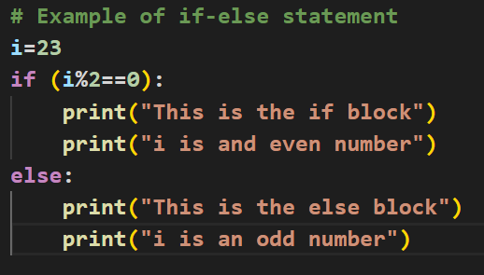
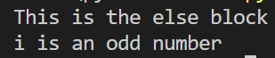
Example:
Output

Slide 18
Nested IF Statement

Slide 19
When an if a statement is present inside another if statement, it is called a nested IF statement. This situation occurs when you have to filter a variable multiple times.

Slide 20
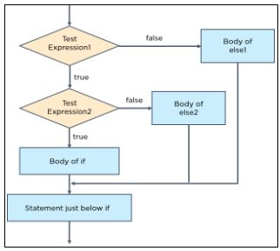
Flow Chart of Nested If Condition

Slide 21
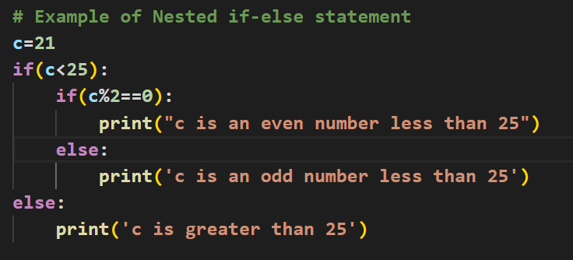

Example:
Output

Slide 22
If - Elif-Else Statement

Slide 23
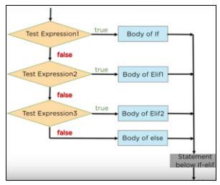
Flow Chart of If – Elif – Else condition

Slide 24
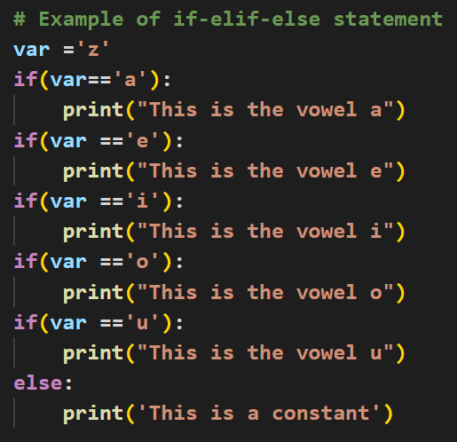
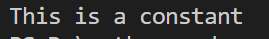
Example:
Output

Slide 25
While Loop

Slide 26
A while loop is a programming construct that repeats a block of code as long as a specified condition is true. It is one of the most commonly used loops in programming, and it can be used to solve a variety of problems.

Slide 27
The condition is a Boolean expression, which means that it can evaluate to either True or False. If the condition is True, the code block inside the loop will be executed. Once the code block has finished executing, the condition will be checked again. If the condition is still True, the code block will be executed again. This process will continue until the condition becomes False.

Slide 28
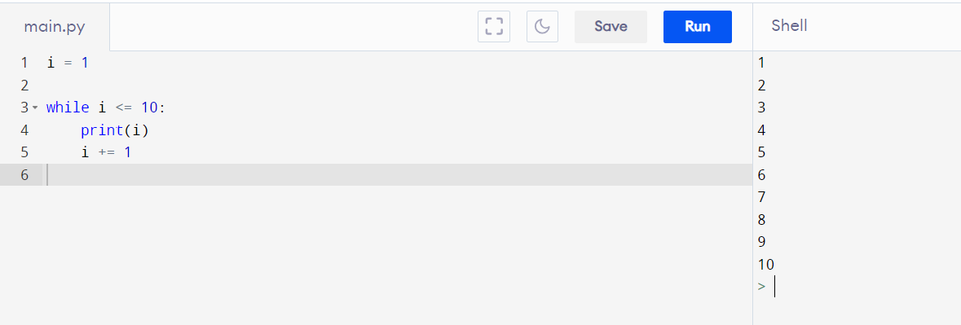
Example:

Slide 29
This code will print the numbers from 1 to 10 to the console. The variable i is used to track the current iteration of the loop. The loop will continue to execute as long as the value of i is less than or equal to 10. Once the value of i becomes 11, the loop will terminate.

Slide 30
Advantages of while loops: Flexibility: While loops are very flexible. They can be used to iterate over any type of data structure and to perform any type of operation. Efficiency: While loops can be very efficient.

Slide 31
FUNCTIONS

Slide 32
Functions are blocks of reusable code that perform a specific task or set of tasks. They allow you to modularize your code and avoid redundancy by encapsulating logic within a named function. Functions can accept parameters (input data) and return results (output data). They are essential for structuring and organizing your code.

Slide 33
Types of Functions in Python
There are mainly two types of functions in Python.
Built-in library function: These are Standard Function in Python that are available to use.
Example: min(), max(), mean().
User-defined function: We can create our own functions based on our requirements.

Slide 34
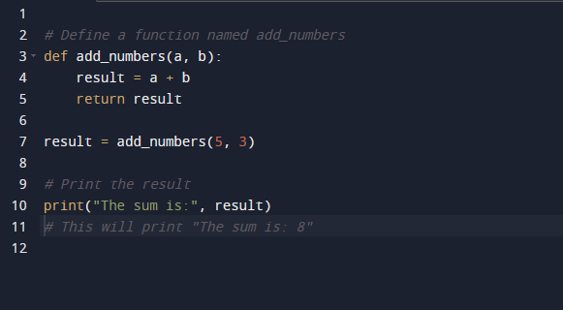
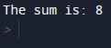
Example

Slide 35
THANK YOU!

